Slide 1

Apache Cassandra
Presented by
Team Cassandra
Team : 1
Members: Ashwin Arun Dixit, Bradley Reardon, Rehapriadarsini Manikandasamy, Wafa Hamad Altuwaijri, Zeqiu Zhang

Slide 2

AGENDA
INTRODUCTION
HIGH-LEVEL ARCHITECTURE
FEATURES
MAIN COMPONENTS
SPECIFIC CHARACTERISTICS
DIFFERENCES & SIMILARITIES WITH DBMS
DIFFERENCES & SIMILARITIES WITH OTHER NOSQL DATABASES
COMPETITIVE ADVANTAGES
LIMITATIONS
PRODUCT INFORMATION
PRODUCT INFORMATION
CASE STUDIES
KEY CUSTOMERS
CONCLUSION
CONCLUSION
REFERENCES

Slide 3

Introduction
What is Cassandra?
Column Oriented NoSQL database management system
Distributed Architecture: high availability with no single point of failure
Open source
History:
Born out of the need for a massive, globally-distributed, always-on, highly available database that could scale to the size of modern web applications and social media
Initial development at Facebook to power the inbox search feature
Made open source in 2009 under Apache Software Foundation
Distributed design based on Amazon’s DynamoDB and data model based on Google’s Big Table

Slide 4
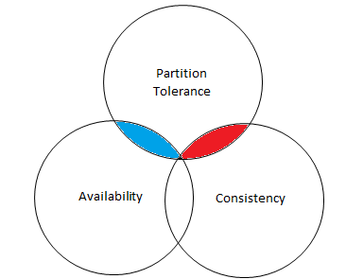
CAP Theorem
For distributed systems, partition tolerance is always a requirement
Distributed systems can operate in 2 basic modes:
Availability-Partition-tolerant (“AP”)
Consistency-Partition-tolerant (“CP”)
Cassandra was originally designed to operate originally as an “AP” mode database – Always available, eventually consistent
Supports “tunable” consistency –
Cassandra can operate somewhat similar to a “CP”-mode database with lightweight transactions and consensus protocols

Slide 5
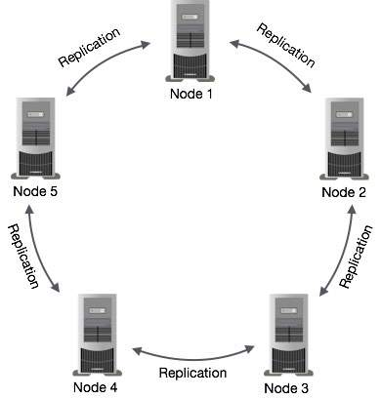
High-level architecture
Peer-to-peer distributed system –
Common topology - Ring
All the nodes in a cluster can play the same role
Each node in a cluster can accept read and write requests regardless of the actual location of data
In-case of node failure, requests can be served from other nodes
Data Replication -
Cassandra stores data replicas on multiple nodes to ensure reliability and fault tolerance
A replication factor of 3 means three copies of each row, where each copy is on a different node
Node Communication -
Nodes communicates with each other through Gossip Protocol that broadcasts information about data and nodes health

Slide 6
Partition methods
Cassandra supports Sharding ( no single point of failure)
The partitioning of data across different nodes happens with the help of “Partition key”
The partition key is hashed with an hashing algorithm
and rows with same partition hash value (Tokens) is
passed to same node
Partition Key → Hash Function → Token
For example, DS → HF → 19
Tokens in Cassandra are 64 bit integers, with range of -2⁶³ to +2⁶³ -1
DS | {Id: 1} | {Name: Sheldon} | {GPA: 3.5}
DS | {Id: 2} | {Name: John} | {GPA: 3.3}
DS | {Id: 3} | {Name: Arya} | {GPA: 3.9}
CSE | {Id: 4} | {Name: Monica} | {GPA: 3.0}
CSE | {Id: 5} | {Name: Joey} | {GPA: 3.6}
CSE | {Id: 6} | {Name: Betty} | {GPA: 3.7}

Slide 7
Cassandra Ring
50/0
Each node in the ring structure holds token value of
particular range
Consider the previous example,
DS → HF → 15
Other than nodes, Cassandra has virtual nodes
40
10
DS
20
30

Slide 8
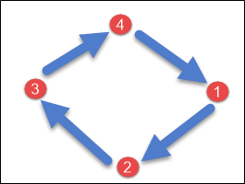
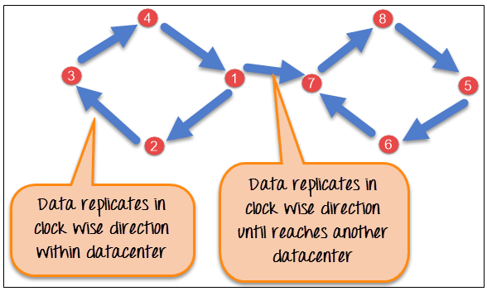
Replication methods
To ensure reliability and fault tolerance, Cassandra stores replica sets in multiple nodes
Data replicas are placed in nodes based on two factors:
Replication Factor – It denotes the total number of replicas present across the cluster
Replication strategy - It determines where the next replica needs to be placed
Simple Strategy Network Topology Strategy
Image source

Slide 9
Map reduce
Cassandra provides built-in support for Hadoop
Programming a map reduce task in Cassandra is similar to programming a map reduce task for data in Hadoop Distributed File System
Installation of Hadoop TaskTracker on each Cassandra node is needed to configure the cluster
One server in the cluster must be dedicated to the Hadoop components (JobTracker, namenode, datanode)
Cassandra supports input to Hadoop with ColumnFamilyInputFormat class and output with ColumnFamilyOutputFormat class

Slide 10
In-memory capability
One of the significant limitation of Cassandra is that it is not an in-memory database
Cassandra is disk based
How to overcome this limitation?
Apache Ignite (an in-memory computing platform) can be placed between Apache Cassandra and an existing application layer without any changes to the Cassandra data and limited changes to the application.

Slide 11
Concurrency & Durability
Concurrency
Cassandra is not truly ACID complaint, but it ensures row-level isolation
It does not use ACID transactions like RDBMS but it offers atomic, isolated and durable transactions
Durability
Data durability in Cassandra is guaranteed by the usage of replicas
Cassandra writes are durable

Slide 12
Support for SQL & Server Operating Systems
Support for SQL
It does not provide support to full set of SQL features
SQL statements: SELECT, INSERT, UPDATE, DELETE
DDL and DML statements are supported for CQL (Cassandra Query Language)
Server Operating Systems
BSD
Linux
OS X
Windows

Slide 13
Cassandra Main Components
Node
A Cassandra node is a place where data is stored.
1
2
Cassandra
Cluster
A cluster is a group of nodes that collectively serve a single system.
The database in Cassandra is made up of many Cassandra Clusters.
Data Center
A data center is a cluster of interconnected nodes.
4
3

Slide 14
Cassandra Characteristics
Elastic scalability
Cassandra is highly scalable.
Cassandra scales horizontally.
Node addition improves efficiency.
1
2
3
4
5
1
2
3
4

Slide 15
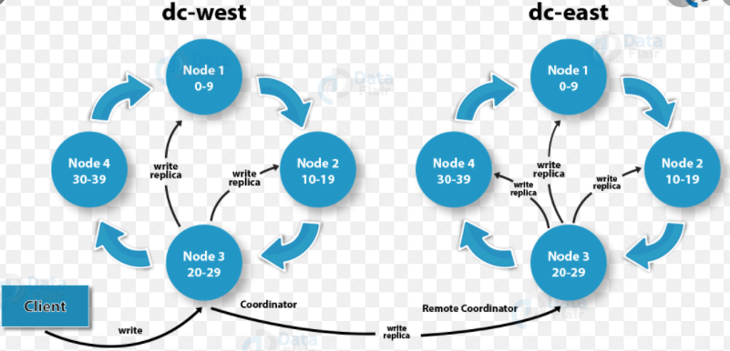
Cassandra Characteristics
Always on architecture
There is no single point of failure for Cassandra.
A cluster's nodes serve as replicas.
Cassandra will return the most recent value to the client if any of the nodes answer with an out-of-date value.
Easy data distribution
By replicating data through various data centers, Cassandra allows you to spread data however you need it.

Slide 16
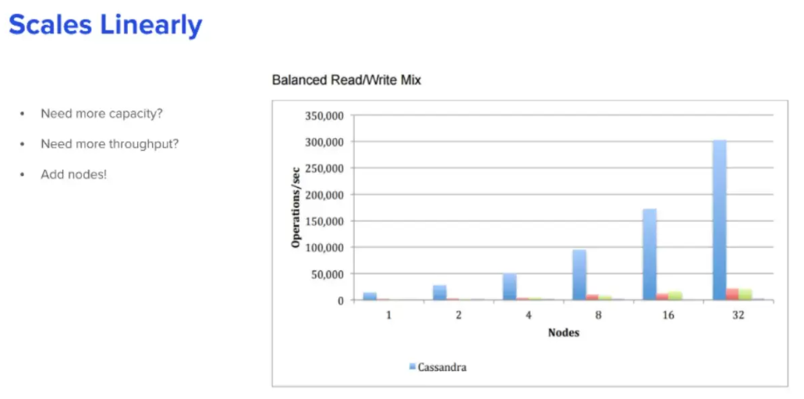
Cassandra Characteristics
Fast linear-scale performance
As the number of nodes in the cluster increase, your throughput increases.
Allows a client to add nodes in a linear fashion without having to deal with the complexities.

Slide 17
Cassandra Characteristics
Flexible data storage
Cassandra can handle all types of data, including structured, semi-structured, and unstructured data. It can dynamically adapt to changes in your data structures based on your requirements.
Fast writes
Cassandra was designed to run on low-cost commodity hardware. It can store hundreds of terabytes of data and performs quick writes without affecting read quality.
High Reliability
Cassandra is designed to manage node failures in the cluster without impacting performance, as it has no single node failure.

Slide 18
Cassandra Data Types
Cassandra Collection Data Type
Built-In Data type
In Cassandra, a collection data type is essentially a unit in which several values are stored.
There are a few collection data types:
list
set
map
Cassandra data types are pre-defined. The user can refer the variables to any of data types.
There are many built-in data types in Cassandra:
Boolean
Decimal
Counter
Double
Float
Int
Collection Data Type
Built-In Data Type
User-Defined Data Type
User-Defined Data Type
Cassandra CQL allows the user to define certain data types. The user may create, alter, drop or describe a data type.
Notes:
Source:
https://data-flair.training/blogs/cassandra-user-defined-types/

Slide 19
Differences with RDBMS
Cassandra (NoSQL DBMS) | RDMBS
Manages unstructured data. | Manages structured data.
Has flexible schema. | Has fixed schema.
In Cassandra, a table is a list of “nested key-value pairs”. [Row x Column Key x Column Value] | In RDBMS, a table is an array of arrays. (Row x Column)
Keyspace is the outermost container which contains data corresponding to an application. | Database is the outermost container which contains data corresponding to an application.
Tables or column families are the entity of a keysapce. | Tables are the entities of database.
Row is a unit of replication. | Row is an individual record.
Column is a unit of storage. | Column represents the attributes of a relation.
Relationships are represented using collections. | There are concepts of foreign keys, joints etc.

Slide 20
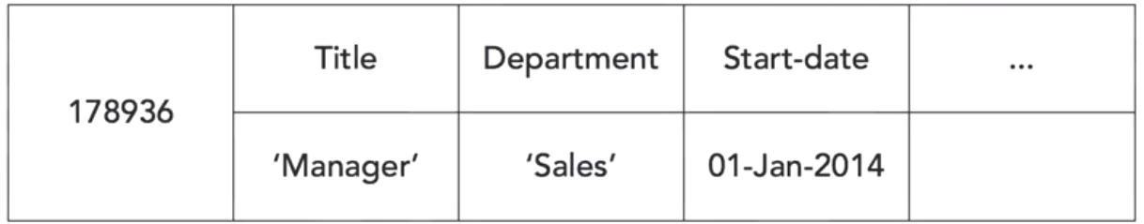
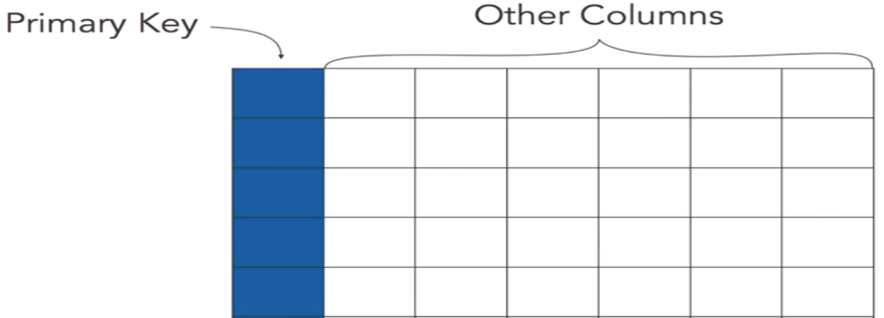
Cassandra Similarities to RDBMS
1) Row of Data: Both use tables as a basic data structure.
2) Primary Key:
Tables are made up of columns that store attributes.
Cassandra uses data types that are familiar to relational database developer such as: integer, fair care, and date.

Slide 21
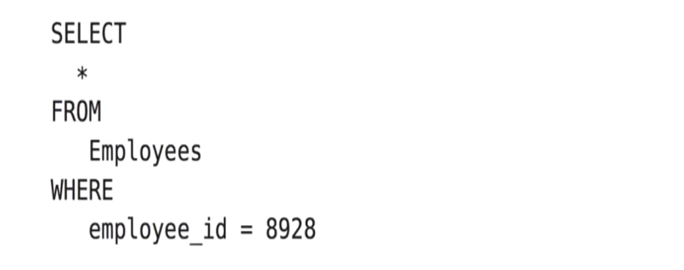
Cassandra Similarities to RDBMS (con’t)
Cassandra Query language (CQL):
It is very similar to SQL in which both languages have similar commands and allow the client to perform the following:
Data Definition Language
Data Manipulation Language
Data Retrieval Query Language
Create table
Create trigger
Create index
Drop index
Update
Cassandra Query Language

Slide 22
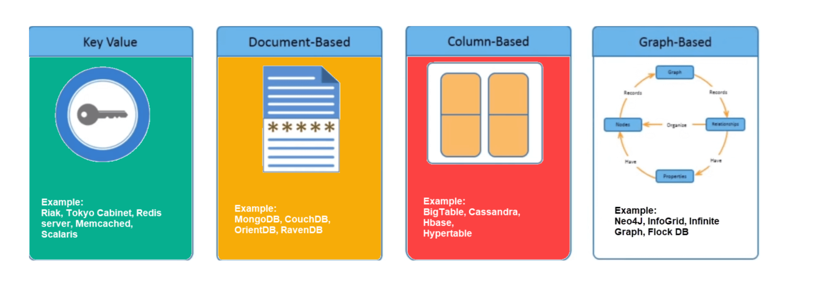
Types of NoSQL Databases

Slide 23


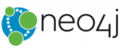
Similarities/Differences
Features
 | Data Model
 | Partitioning Methods
 | Scalability
 | Query Language
 | Replication Methods
 | Secondary Index
 | Foreign Keys | F
 | Wide Column Store
 | Sharding
 | High writing scalability
 | CQL
 | Selectable Replication Factor
 | Restricted Secondary Index
 | No
 | Document Store
 | Sharding
 | Limited writing scalability
 | Structure queries in JSON Fragments
 | Master-Slave Replication
 | Yes
 | No
 | Graph-based
 | None
 | Critical Scalability
 | Cypher
 | Clustering
 | Yes
 | Yes
Aggregation
Does not support Aggregation
Provides Aggregation
Cypher offers Aggregation
Transaction Concepts
Not compliant to ACID
Supports Multi-Document ACID Transactions
ACID-Compliant Database

Slide 24
When to use Cassandra?
If you have a requirement for a distributed application.
Runs on more than one server node.
Cassandra clusters are always available.
Data is stored on multiple nodes and in multiple data centers.
Use it for large data.
If the data requires fast writes.
A cluster may be geographically distributed.
Distributed
Scale linearly
Work globally
Favor writes
over reads
Data
replication

Slide 25
When not to use Cassandra?
Does not support ACID
Does not work well with updates
Does not support aggregates
Does not have strong consistency
Lots of scans

Slide 26

Licensing
Open Source:
Apache Version 2
Pricing models:
Pricing for commercial distributions provided by DataStax and available upon request.

Slide 27
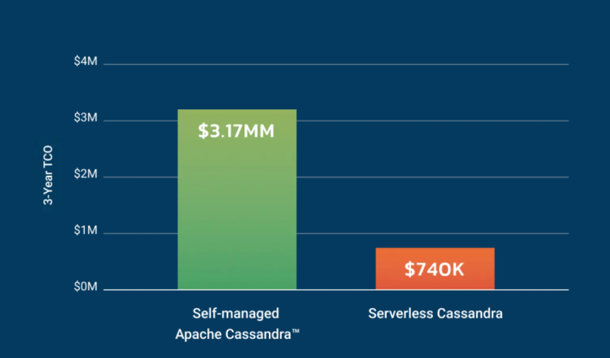
Cloud option
Cassandra is not only available as a cloud service.

Slide 28
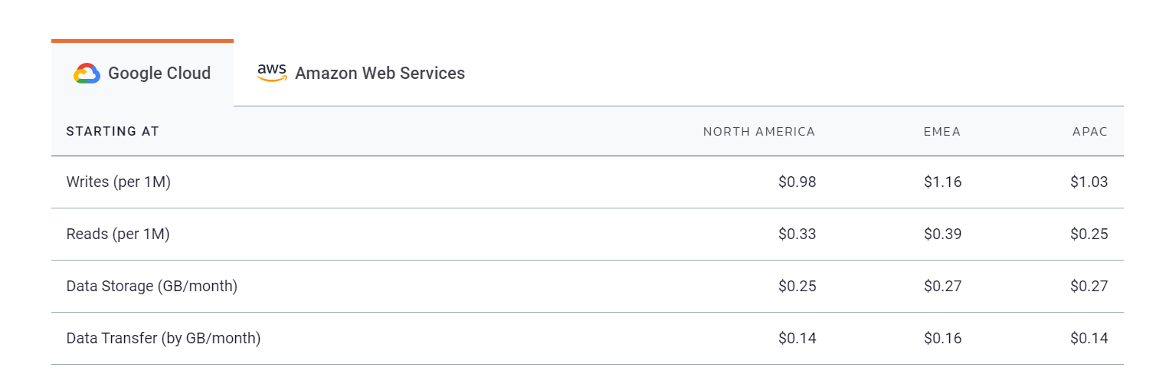
Pricing
If using their cloud service cloud service:

Slide 29
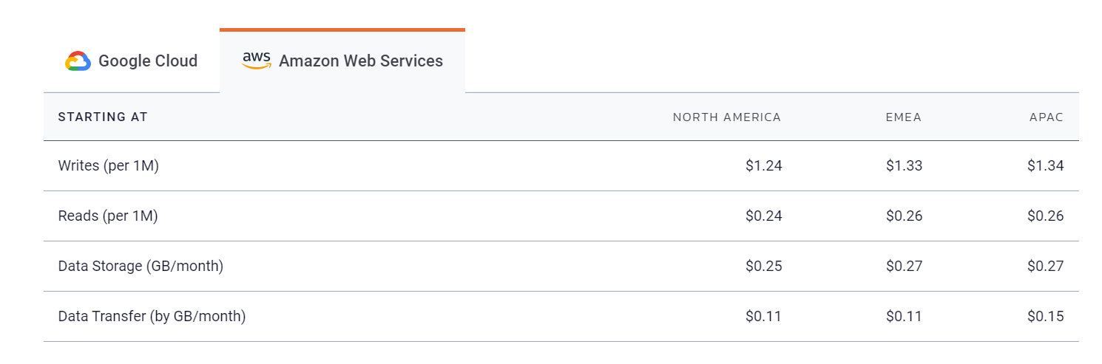
Pricing

Slide 30
Market Metrics
Cassandra is used by 40% of the Fortune 100.
Why these companies use Cassandra?

Slide 31




Case Studies

Slide 32
Case Studies
Why Cassandra?
Cassandra can operate with petabyte-level data
Pairs well with applications that require fast performance and no downtime
iTunes, iMessage, iCloud, Apple Store, etc.
“Cassandra offers Apple the scale and increasingly the analytical horsepower to tackle an ever-expanding array of applications.” – techrepublic.com

Slide 33
Case Studies
Benefits
Apple was able to run over 75,000 Cassandra nodes in 2015
Storing more than 10 petabytes of data
At least one cluster was over 1,000 nodes
Apple regularly gets millions of operations per second (reads/writes) with Cassandra
Able to store all iTunes, iMessage, and iCloud data in one database

Slide 34
Case Studies
Challenges
Cassandra uses disk storage as its primary data storage method
Often runs slowly with Apple’s large number of nodes (75,000+)
Led to Apple considering switching to FoundationDB
FoundationDB operates primarily on cheaper and faster hardware (RAM)
Potential 10% reduction in node count (7,500 nodes)

Slide 35
Case Studies
Why Cassandra?
Adopted Cassandra to deal with petabyte scale in the cloud
Highly efficient with writes
Read/write ratio is about 9:1
Netflix has a write heavy workload
Scalability
Scales vertically and dynamically by adding more servers
Similar to previous NoSQL Database (SimpleDB) but without the limits

Slide 36
Case Studies
Benefits
High scale allows for efficient data back-ups
Netflix has Cassandra configured to keep 3 copies of all Netflix’s data.
No limitations on data sizes or row/column counts
Cross-regional deployment
Simultaneously service applications and asynchronously replicate data across multiple geographic locations
98% of streaming data is stored in Cassandra

Slide 37
Case Studies
Challenges
In 2014, Amazon performed a major maintenance update
Affected 218 of the 2700+ production Cassandra nodes
22 were on hardware that did not boot successfully and they never came back online

Slide 38
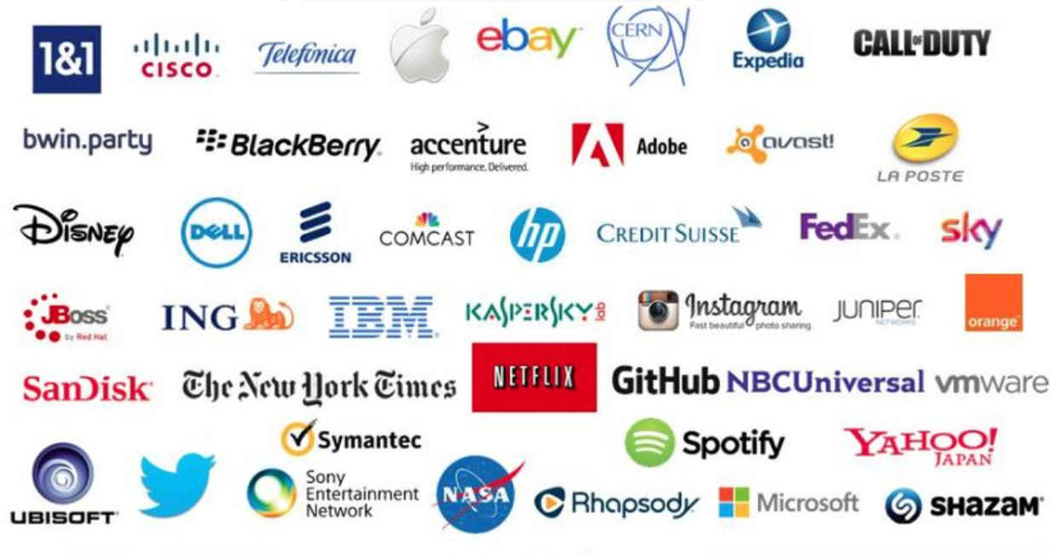
Key Customers
eBay
APPLE
GitHub
Netflix
Notes:
Cassandra is used by 40% of the Fortune 100 companies!

Slide 39
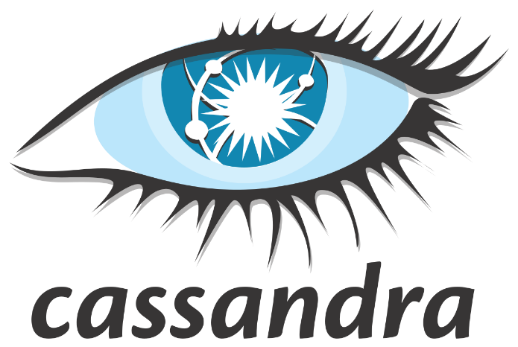
Conclusion
Cassandra…
is a great column oriented NoSQL database used for storing petabyte-level data
has high availability with no single point of failure
pairs well with applications that require fast performance and no downtime
has a similar query language SQL

Slide 40
References
https://cassandra.apache.org/
https://www.techrepublic.com/article/apples-secret-nosql-sauce-includes-a-hefty-dose-of-cassandra/
https://netflixtechblog.com/scaling-time-series-data-storage-part-i-ec2b6d44ba39
https://readwrite.com/2011/01/28/how-netflix-adopted-nosql/
https://www.infoq.com/news/2014/10/netflix-cassandra/
https://subscription.packtpub.com/book/big_data_and_business_intelligence/9781782162681/8/ch08lvl1sec47/cassandra-with-hadoop-mapreduce
https://www.infoworld.com/article/3191895/light-a-fire-under-cassandra-with-apache-ignite.html
https://teddyma.gitbooks.io/learncassandra/content/concurrent/concurrency_control.html

Slide 41

THANK YOU

